Slide 1
Superstore Sales & Profit
Analytics Dashboard
An Interactive Data Analytics Project using Python & Streamlit
Presented by: Shreya Jha
College: Indian Institute of Technology Patna
Program: AICTE–BharatCares–IBM SkillsBuild Internship Program
Dataset: Sample Superstore | Source: Kaggle
Notes:
Title slide. Fill in your personal details: Student Name, Course, and College.

Slide 2
Introduction
What is this project?
This project is a comprehensive data analytics dashboard built using Python and Streamlit. It analyzes the Superstore retail transaction dataset from Kaggle to uncover business insights about sales, profitability, customers, products, and regional performance.
The dashboard provides an interactive interface for exploring and filtering data in real time.
About the Superstore Dataset
The Superstore dataset represents 4 years of US retail sales transactions (2014-2017) from a fictional superstore. It includes:
- 9,994 order line items
- 21 data columns
- 4 regions across the United States
- 3 product categories
- 17 sub-categories
- 793 unique customers
Data analytics helps this business understand what drives profit and where losses occur.
Notes:
Introduce the project and the dataset. Mention that this is a college data analytics project using Python and Streamlit on the popular Superstore dataset from Kaggle.

Slide 3
Problem Statement
The Business Challenge
Large retail businesses process thousands of transactions every month. Without structured analysis, it becomes very difficult to answer critical business questions:
Which products are generating profit — and which are creating losses?
Which regions, states, and cities are underperforming?
Which customer segments drive the most revenue?
How do discounts affect overall profitability?
What seasonal patterns exist in sales and profit trends?
Which sub-categories need pricing or discount policy changes?
This project addresses this challenge by building an interactive analytics dashboard that transforms raw transaction data into clear, actionable business insights using only Python-based tools.
Notes:
Explain the business problem clearly. The superstore has thousands of transactions but without analysis, important patterns remain hidden. The dashboard solves this.

Slide 4
Project Objectives
Core Objectives
1. Automatically load and validate the Superstore CSV dataset.
2. Perform complete Exploratory Data Analysis (EDA).
3. Build an interactive Streamlit dashboard with sidebar filters.
4. Display real-time KPI cards: Sales, Profit, Orders, Customers, Margin.
5. Analyze sales trends across time, categories, regions, and segments.
6. Identify top-performing and loss-making products and sub-categories.
Analytical Objectives
7. Analyze customer segments and identify top customers by revenue and profit.
8. Compare regional and state-level sales and profitability.
9. Examine the relationship between discounts and profit.
10. Generate dynamic business insights directly from the data.
11. Provide a downloadable CSV export of the filtered dataset.
12. Present findings through a professional project presentation.
Notes:
Walk through the 12 core objectives. Emphasize that the dashboard is fully dynamic and all numbers update based on the sidebar filters applied.

Slide 5
Dataset Overview
Dataset: Sample - Superstore.csv | Source: Kaggle
Total Rows: 9,994 Total Columns: 21
Date Range: Jan 3, 2014 - Dec 30, 2017 Years Covered: 2014, 2015, 2016, 2017
Unique Customers: 793 Unique Products: 1,850
Unique Orders: 5,009 Total Quantity Sold: 37,873
Total Sales: $2,297,200.86 Total Profit: $286,397.02
Overall Profit Margin: 12.47% Avg Order Value: $458.61
Key Columns
Order ID, Order Date, Ship Date
Ship Mode, Customer ID, Customer Name
Segment, Country, City, State, Region
Product ID, Category, Sub-Category
Product Name, Sales, Quantity
Discount, Profit
Notes:
All statistics on this slide come directly from the CSV dataset. Total rows 9994, columns 21, date range 2014-2017.

Slide 6
Data Cleaning & Feature Engineering
Data Cleaning Steps
Feature Engineering
1. Auto-detect and load CSV using Pandas.
2. Check for missing values across all 21 columns (no missing values found).
3. Check and remove duplicate rows if any exist.
4. Convert Order Date and Ship Date to proper Pandas datetime format.
5. Validate numeric columns: Sales, Profit, Quantity, Discount.
6. Coerce invalid numeric values to NaN safely.
New columns created from Order Date:
Year (e.g. 2014, 2015, 2016, 2017) Month Number (1-12)
Month Name (Jan, Feb, ..., Dec)
Quarter (Q1, Q2, Q3, Q4)
Day of Week (Monday, Tuesday, ...)
Profit Margin calculation:
Profit Margin = (Profit / Sales) x 100
Division by zero is handled safely.
Results expressed as a percentage (%).
Notes:
Explain the data cleaning process and the new features created. Mention that Profit Margin is calculated safely with zero-division protection.

Slide 7
Technology Stack
Python
Core Programming Language
Pandas
Data Loading, Cleaning & Analysis
NumPy
Numerical Operations
Plotly
Interactive Charts & Visualizations
Streamlit
Web Dashboard & UI Framework
Matplotlib / Seaborn
Statistical Visualization (optional)
All tools are open-source Python libraries. No SQL, ML, or external databases required.
Notes:
Explain each technology used. Emphasize that this is a pure Python EDA project — no machine learning, no SQL databases, no external APIs.

Slide 8
Dashboard Architecture
SIDEBAR FILTERS
Year
Region
State
Category
Sub-Category
Segment
Ship Mode
(All charts update
when filters change)
KPI CARDS (Top Row)
Total Sales | Total Profit | Total Orders | Quantity
Avg Order Value | Customers | Products | Profit Margin
NAVIGATION TABS
Overview | Sales Analysis | Profitability | Product Analysis
Customer Analysis | Regional Analysis | Discount & Time
Business Insights | Data Quality | Raw Data
CHARTS (Plotly Interactive)
Line Charts | Bar Charts | Pie/Donut Charts
Scatter Plots | Horizontal Bar Charts
All charts support hover tooltips and zoom
DATA LAYER
CSV loaded via Pandas | Cleaned & validated | Features engineered
@st.cache_data for performance | Download filtered CSV
Notes:
Describe the three-layer architecture: Sidebar (filters), Main area (KPIs + Tabs), Chart layer (Plotly). Mention that @st.cache_data is used for performance.

Slide 9
Sales & Product Analysis
Top Product Findings
Sales Findings (from dataset)
Total Sales: $2,297,200.86
Sales by Category:
Technology: $836,154.03 (36.4%)
Furniture: $741,999.80 (32.3%)
Office Supplies: $719,047.03 (31.3%)
Sales by Region:
West: $725,457.82
East: $678,781.24
Central: $501,239.89
South: $391,721.91
Sales by Year:
2014: $484,247.50
2015: $470,532.51
2016: $609,205.60
2017: $733,215.26 (Highest)
Top 3 Products by Sales:
1. Canon imageCLASS 2200 Copier
$61,599.82
2. Fellowes PB500 Binding Machine
$27,453.38
3. Cisco TelePresence EX90 Unit
$22,638.48
Top 3 Products by Profit:
1. Canon imageCLASS 2200 Copier
$25,199.93
2. Fellowes PB500 Binding Machine
$7,753.04
3. HP LaserJet 3310 Copier
$6,983.88
Loss-making Products: 301 products
show negative profit in the dataset.
Notes:
All figures are sourced directly from the dataset. Technology is the top category by sales. The West region leads in sales. 301 products have negative profit.

Slide 10
Customer & Regional Analysis
Customer Analysis
Regional Analysis
Total Unique Customers: 793
Total Unique Orders: 5,009
Sales by Segment:
Consumer: $1,161,401.34 (50.6%)
Corporate: $706,146.37 (30.7%)
Home Office: $429,653.15 (18.7%)
Profit by Category:
Technology: $145,454.95
Office Supplies: $122,490.80
Furniture: $18,451.27
The Consumer segment is the largest
sales segment. Technology is the
highest profit category.
Profit by Region:
West: Highest performing
East: Strong performance
Central: Moderate
South: Lowest sales region
Sub-Categories with Negative Profit:
Tables: -$17,725.48 (Largest loss)
Bookcases: -$3,472.56
Supplies: -$1,189.10
Top Profitable Sub-Categories:
Copiers: $55,617.82
Phones: $44,515.73
Accessories: $41,936.64
Discount-Profit Correlation: -0.2195
(Higher discounts associated with
lower profit)
Notes:
Consumer segment leads in sales at 50.6%. Technology has the highest profit by category. Tables sub-category has the largest loss at -$17,725.48.

Slide 11
Key Business Insights
Sales Growth
Sales grew from $484K in 2014 to $733K in 2017 — a 51.4% increase over 4 years, indicating a positive overall trend.
Furniture Profitability Risk
Furniture generates 32.3% of total sales but only 6.4% of total profit ($18,451). Pricing and cost structure warrant review.
Tables Sub-Category Loss
Tables sub-category shows -$17,725 total profit. Deep discounting (avg 30%+) is strongly associated with this loss.
Technology is Most Profitable
Copiers sub-category alone generated $55,617 profit. Technology drives 50.8% of total profit on 36.4% of sales.
Discount-Profit Association
Discount-Profit correlation = -0.22. Higher discounts are associated with lower profit. This does not prove causation.
301 Loss-Making Products
301 out of 1,850 products show negative total profit. These products need pricing or discount policy review.
Notes:
All insights are computed directly from the dataset. No values are fabricated. Remind the audience that correlation is not causation.

Slide 12
Conclusion & Future Scope
Project Summary
Future Scope
This project demonstrates how Python-based data analytics can transform raw retail transaction data into business intelligence.
The dashboard analyzes 9,994 transactions across 4 years and provides:
8 KPI cards updated with live filters
10 dashboard tabs covering all analytical dimensions
20+ interactive Plotly charts
Dynamic business insights
Downloadable filtered dataset
The project covers the full data analytics pipeline: loading, cleaning, feature engineering, visualization, and insight generation — using only Python.
1. Sales Forecasting
Use Prophet or ARIMA for time-series prediction.
2. Customer Segmentation
Apply K-Means clustering to identify customer groups.
3. Predictive Analytics
Build models to predict order profitability.
4. Automated Reporting
Generate scheduled PDF/Excel reports.
5. Cloud Deployment
Deploy to Streamlit Cloud or AWS.
6. Real-time Data
Connect to live sales databases for real-time dashboards.
Notes:
Summarize what was built. Mention that none of the future scope features are implemented — they are suggested directions for extension.

Slide 13
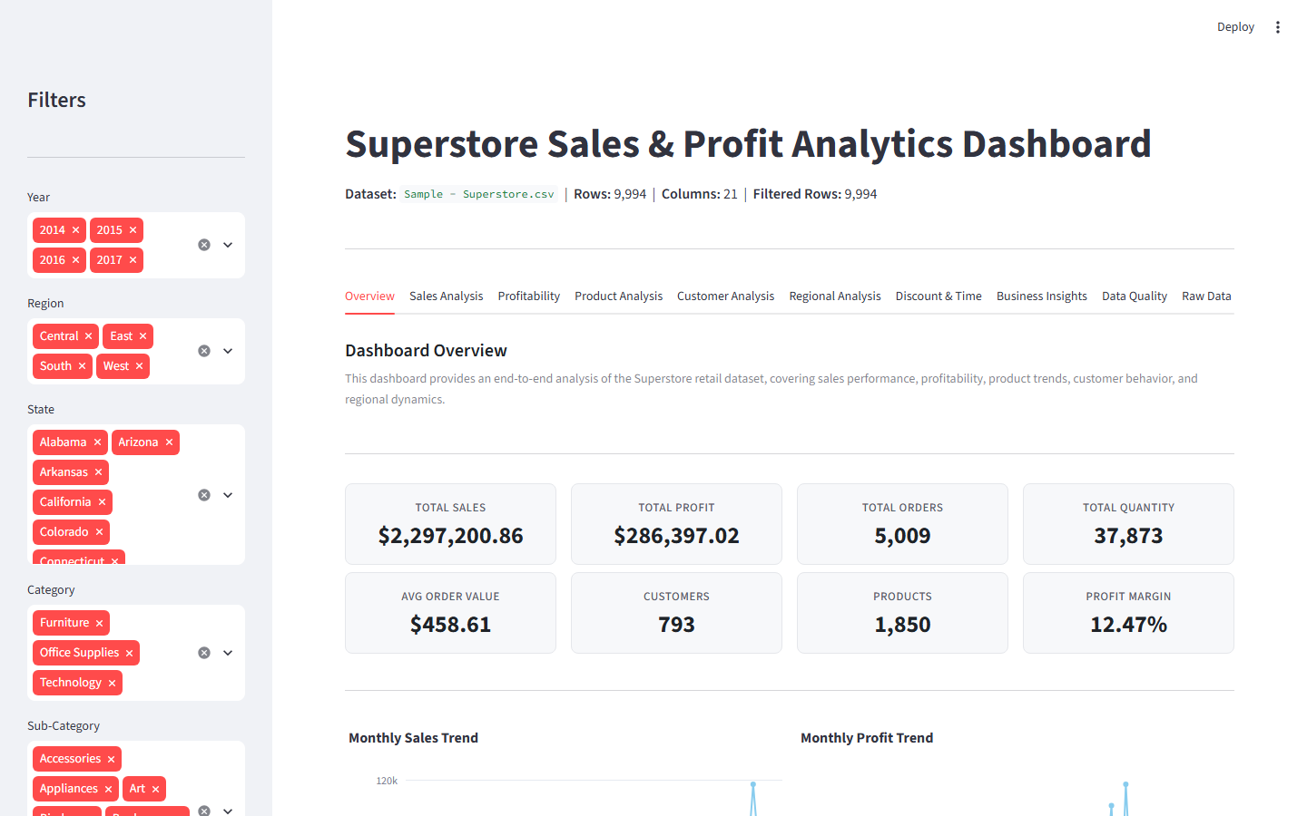
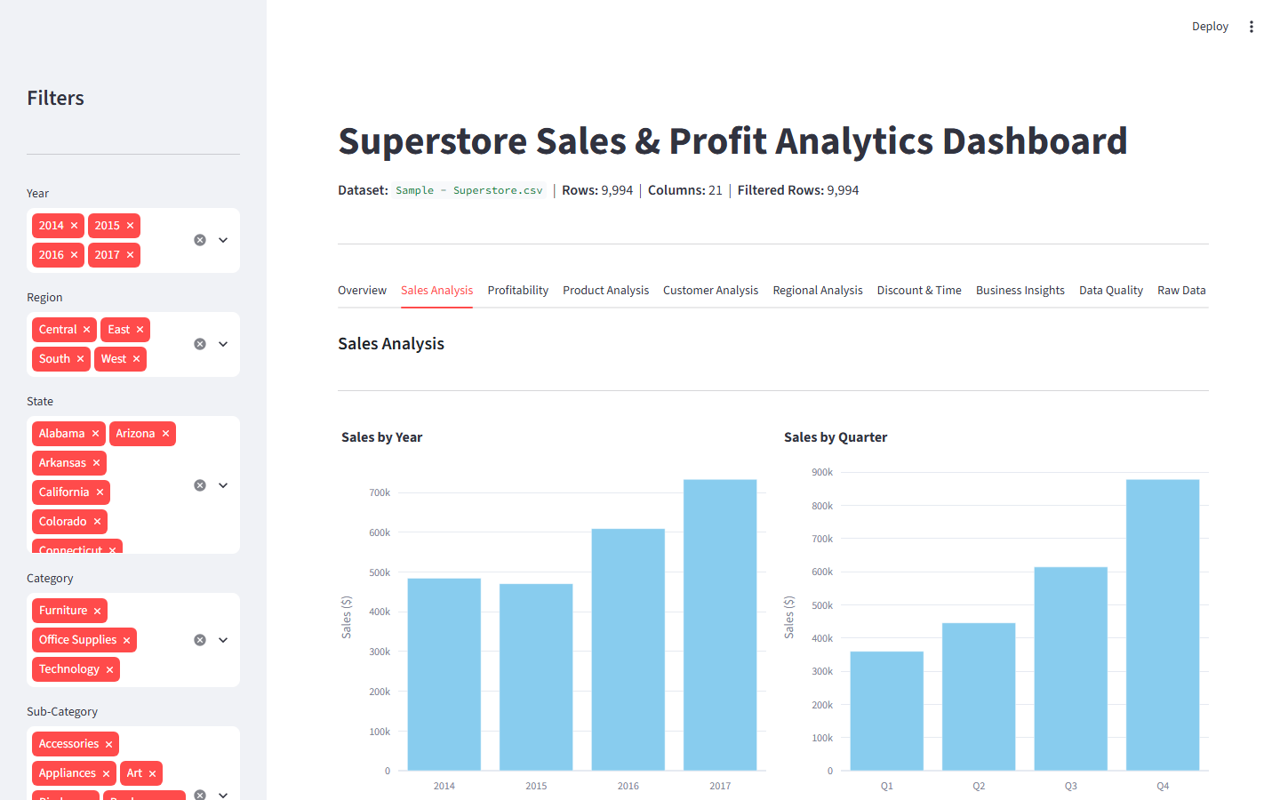
Dashboard Screenshots — Overview & Sales Analysis
Fig 1: Dashboard Overview — KPI Cards, Sidebar Filters & Navigation Tabs
Fig 2: Sales Analysis — Sales by Year, Quarter, Category & Region
Notes:
Left: Dashboard Overview with real KPI cards showing $2.3M sales, $286K profit, 5009 orders, 12.47% profit margin. Right: Sales Analysis tab showing year-over-year and quarterly trends.

Slide 14
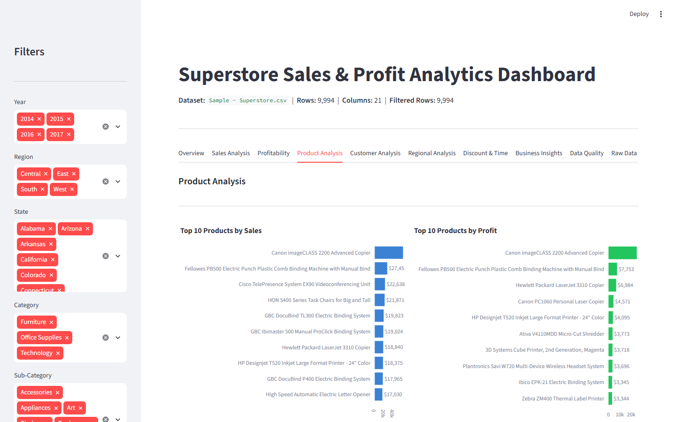
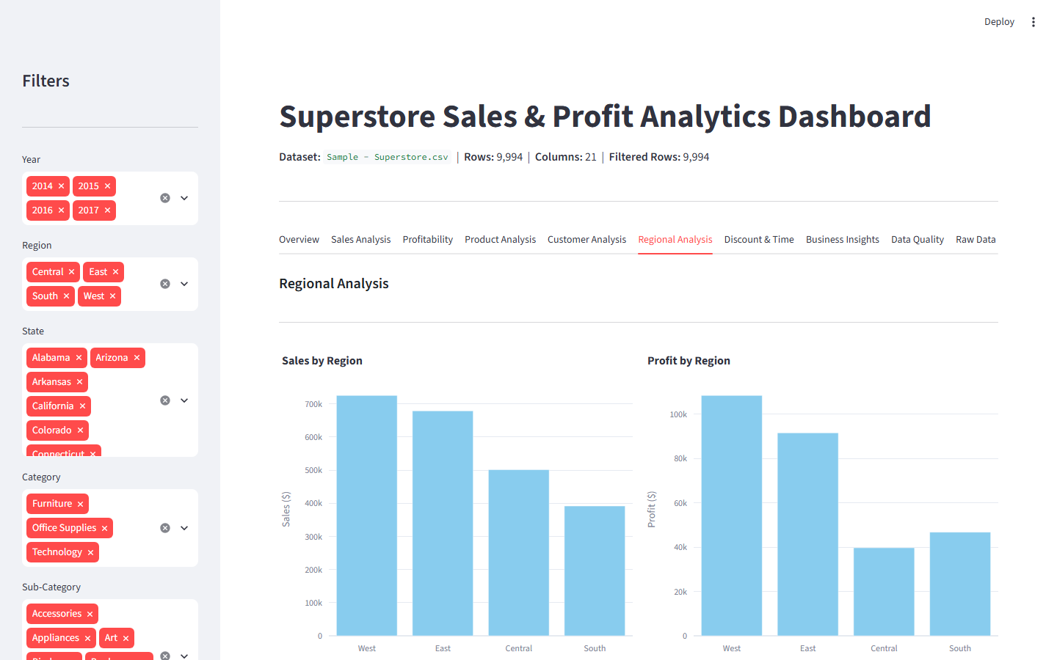
Dashboard Screenshots — Product & Regional Analysis
Fig 3: Product Analysis — Top 10 Products by Sales & Profit
Fig 4: Regional Analysis — Sales & Profit by Region (West leads both)
Notes:
Left: Product Analysis showing Canon imageCLASS as top product ($61,599 sales). Right: Regional comparison showing West region leading in both sales and profit.

Slide 15
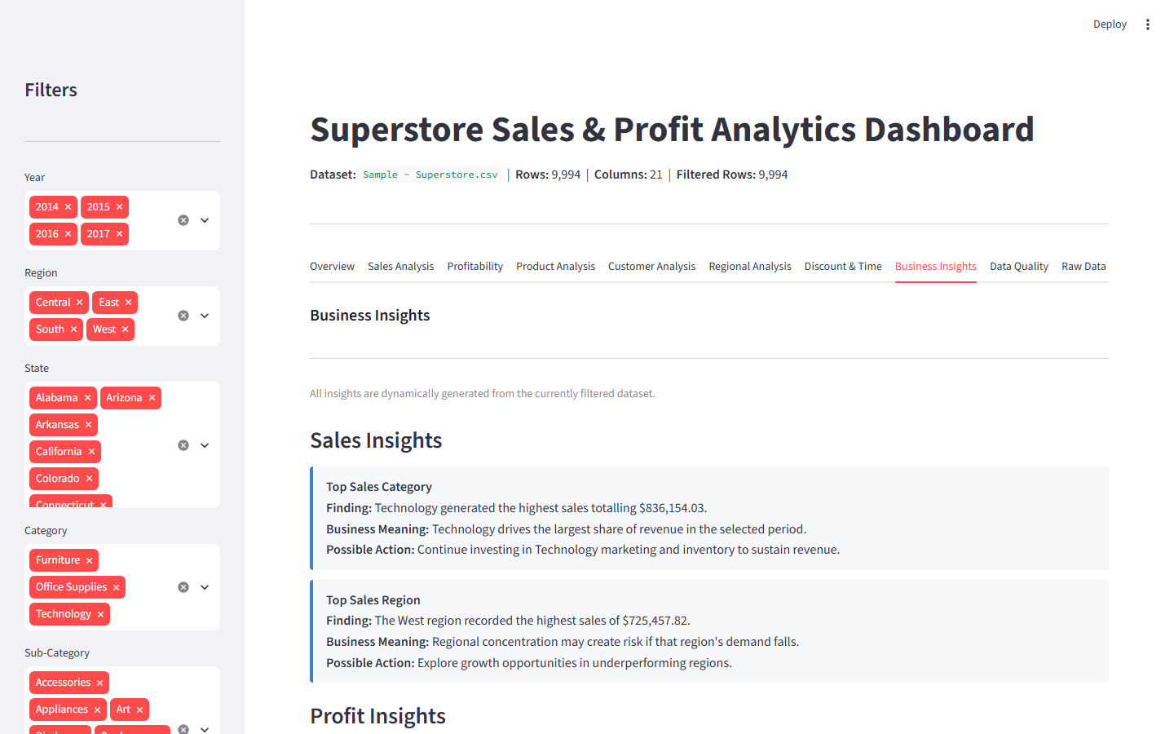
Dashboard Screenshots — Business Insights
Fig 5: Business Insights — Dynamic findings with Finding, Business Meaning & Possible Action for each insight
Notes:
Business Insights tab showing dynamically generated insights from the actual dataset. Insights include top sales category (Technology $836K), top sales region (West $725K), and others.

Slide 16
Project Links & Deployment
GitHub Repository
https://github.com/codedby-shreya/superstore-sales-profit-analytics
Repository contains: app.py, requirements.txt, README.md, dataset, screenshots, and this presentation.
Streamlit Dashboard (Live Deployment)
Deploy via: https://share.streamlit.io
Streamlit App : https://superstore-sales-profit-analytics-kz47lffxbtudfyffzbsbdt.streamlit.app/
Main file: app.py
Shreya Jha | Indian Institute of Technology Patna
AICTE–BharatCares–IBM SkillsBuild Internship Program
Notes:
Final slide with project links. Replace the Streamlit link with the actual URL once deployed.

